Slide 1
Coded Extraction and Validations & Create Plugins
Day 4 - Chapter 1

Slide 2
Create Extraction & Validation Plugin
Custom extraction code and plugin
https://msdn.microsoft.com/en-us/library/ee923683.aspx
Custom validation code and plugin
https://msdn.microsoft.com/en-us/library/ms182556.aspx
Basics about Base class and Event handler
https://msdn.microsoft.com/en-us/library/dn448570.aspx
https://msdn.microsoft.com/en-us/library/ms243191.aspx?f=255&MSPPError=-2147217396

Slide 3
Create Request Plugin
Request Level Plugin
https://msdn.microsoft.com/en-us/library/bb514192.aspx

Slide 4
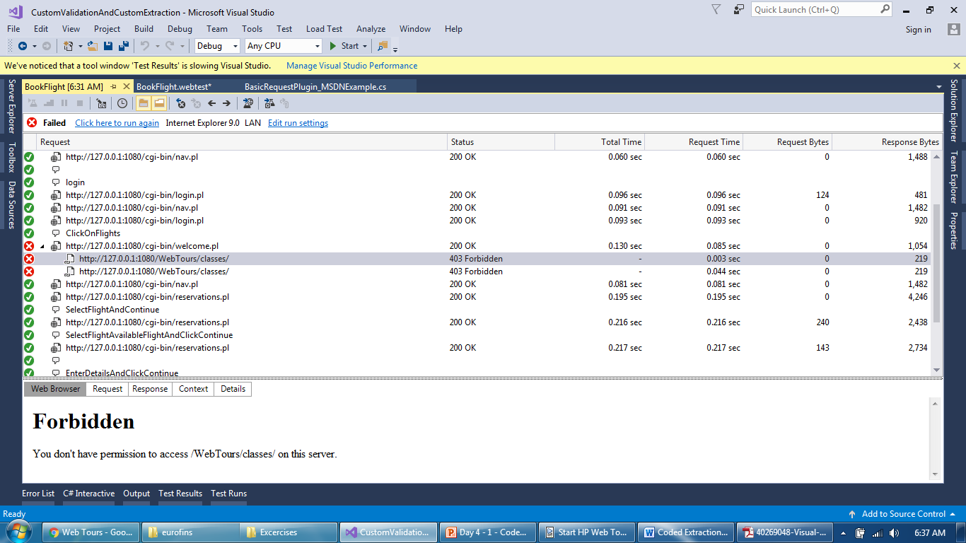
Validation and Request plugin
In case of error, redirect request to a new or home page

Slide 5
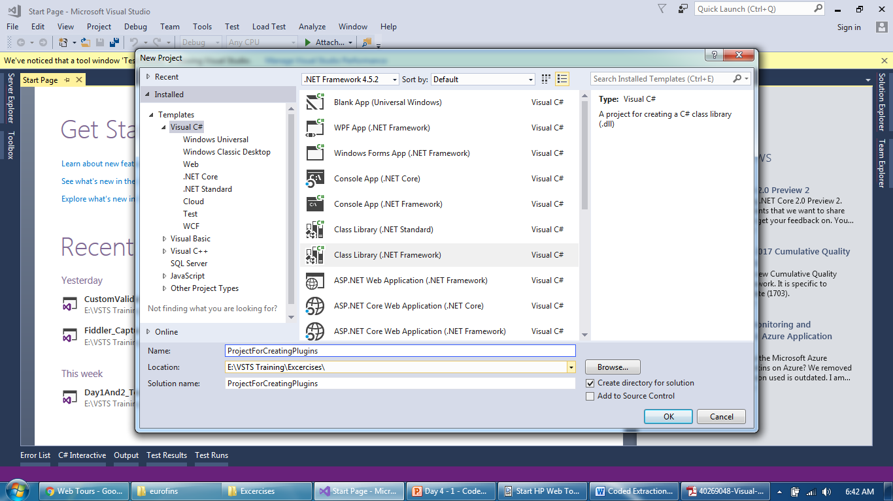
Validation and Request plugin
Create a new project and a class

Slide 6
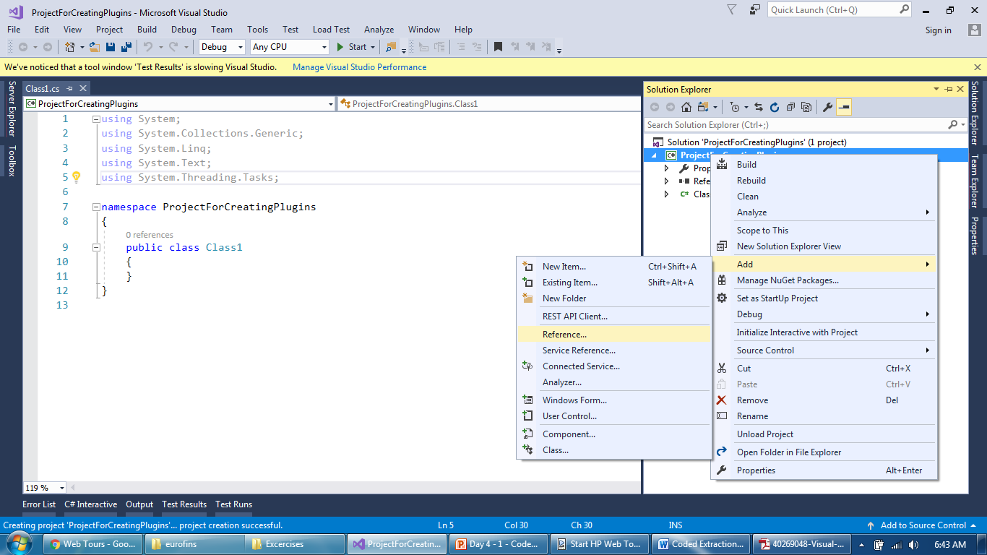
Validation and Request plugin
Add a reference of base package

Slide 7
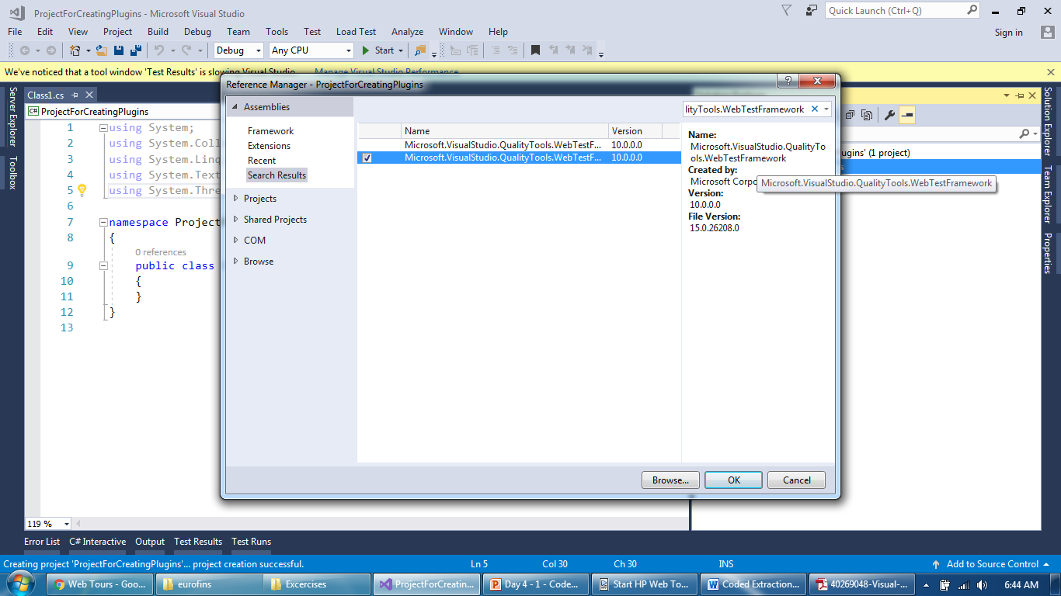
Validation and Request plugin
Add “Microsoft.VisualStudio.QualityTools.WebTestFramework”

Slide 8
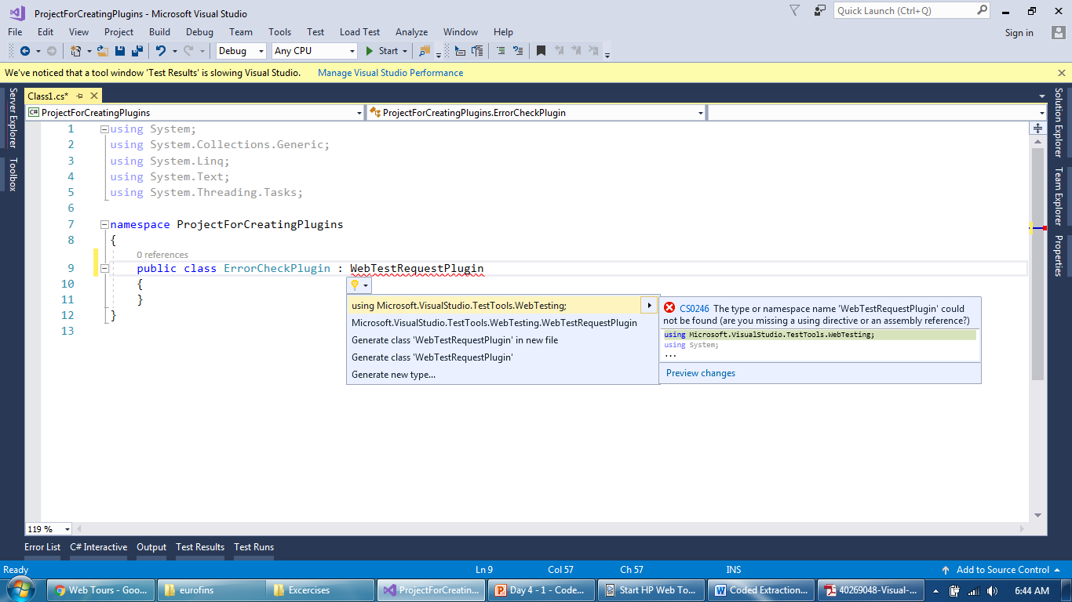
Validation and Request plugin
Extend a “web request” base class (WebTestRequestPlugin)

Slide 9
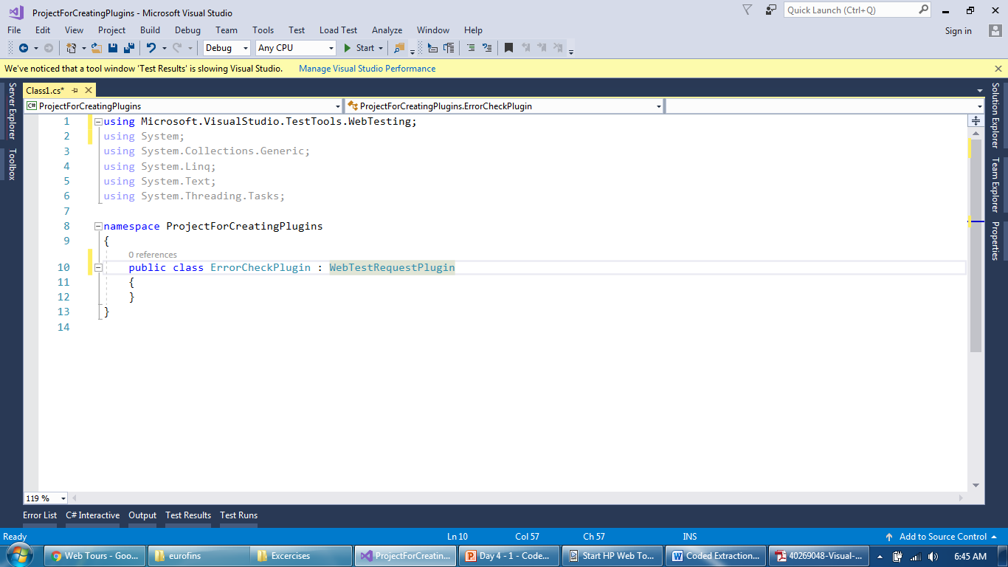
Validation and Request plugin
It will add another package with name ending “WebTest”

Slide 10
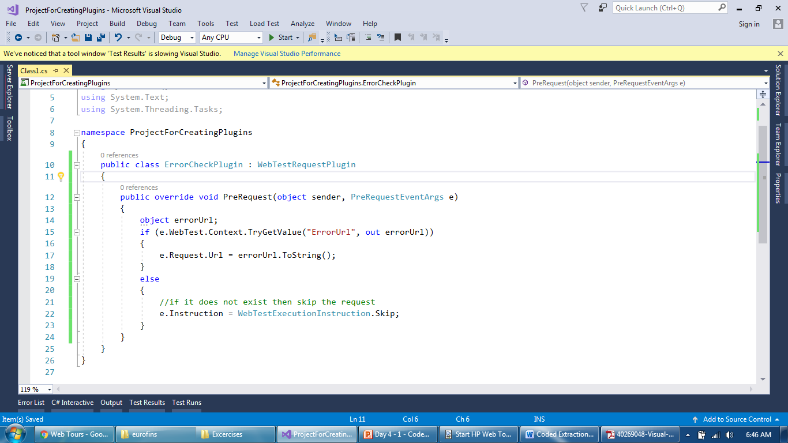
Validation and Request plugin
Implement PreRequest with your logic

Slide 11
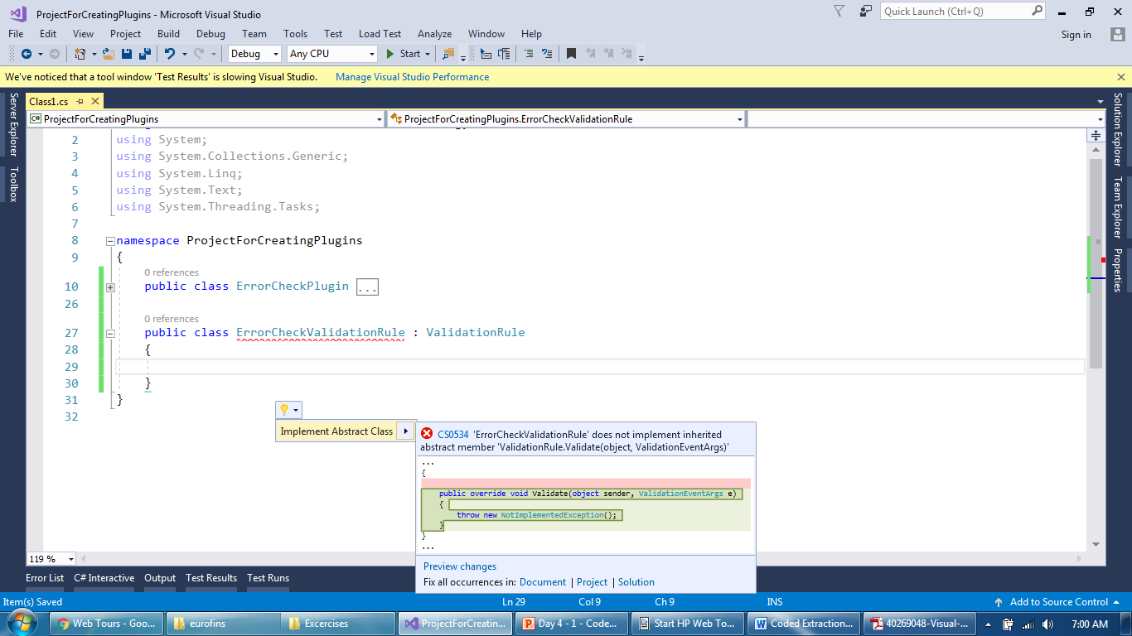
Validation and Request plugin
Create a custom validation class and extend ValidationRule

Slide 12
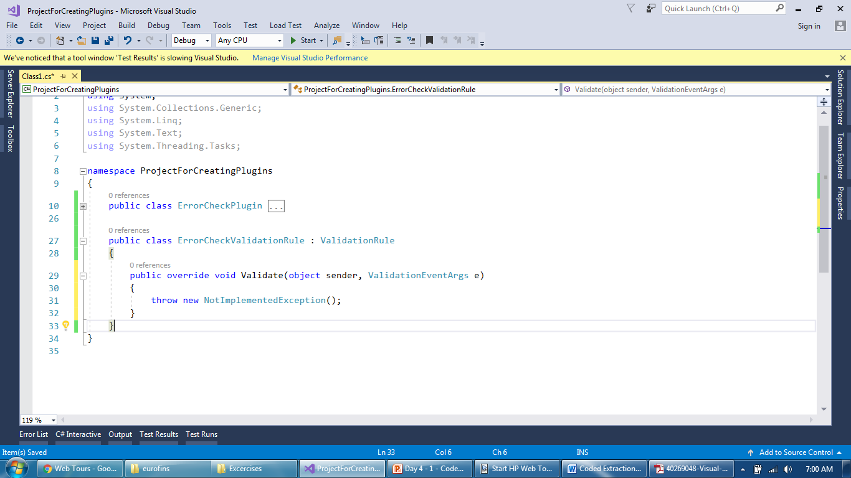
Validation and Request plugin
Implement validate method

Slide 13
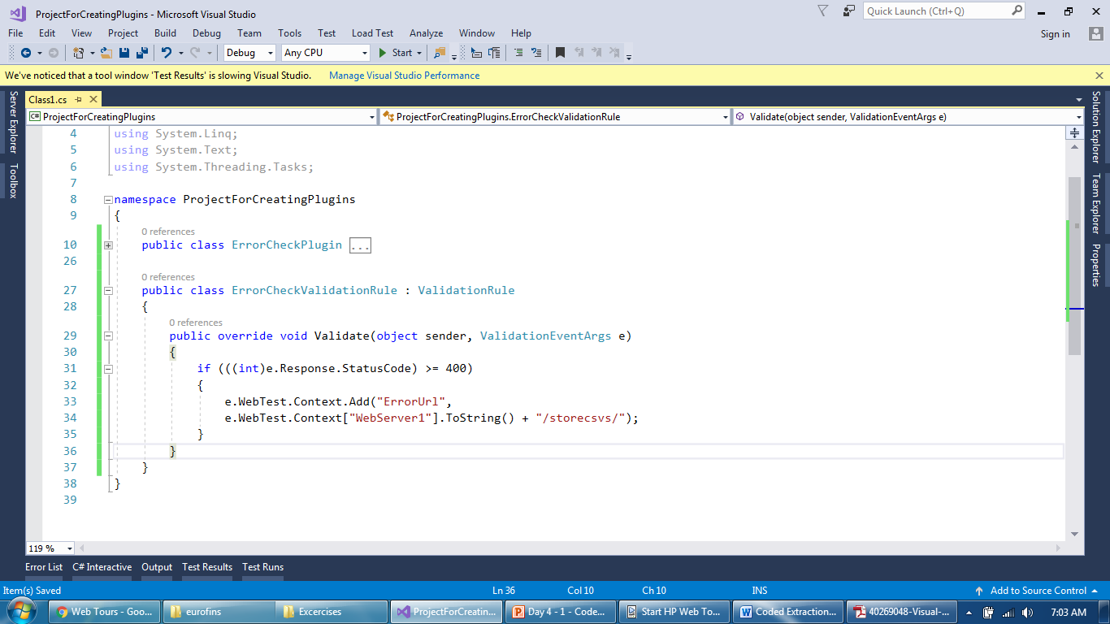
Validation and Request plugin
Add a logic to set ErrorURL CP if response is greater than 400

Slide 14
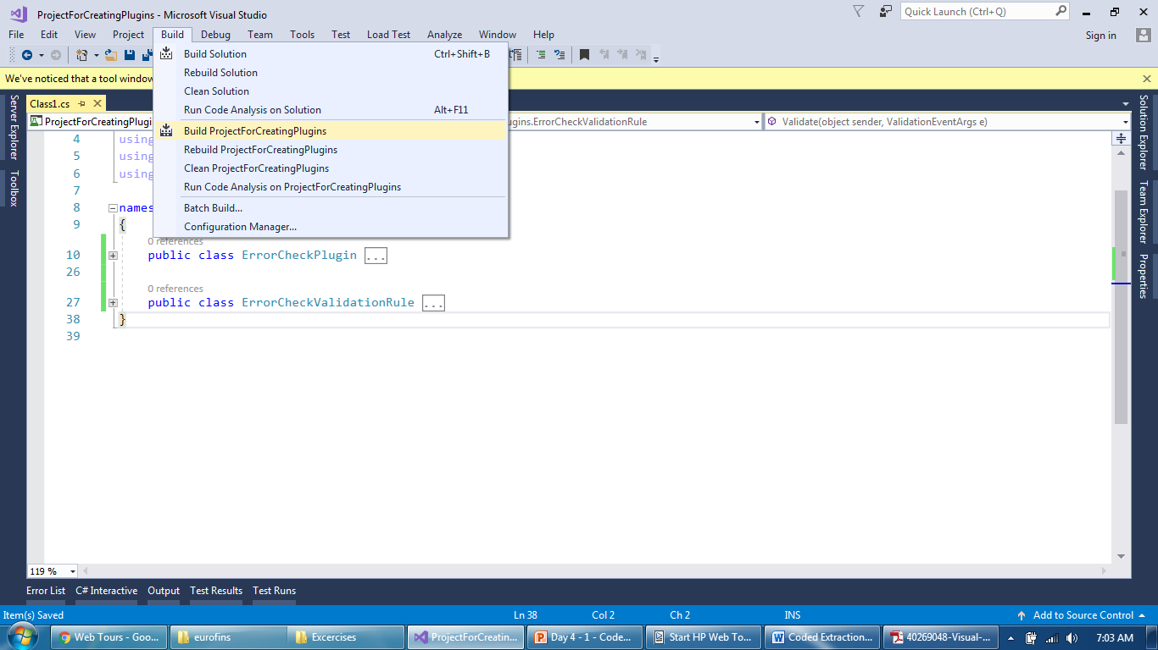
Validation and Request plugin
Build a project to create a DLL file

Slide 15
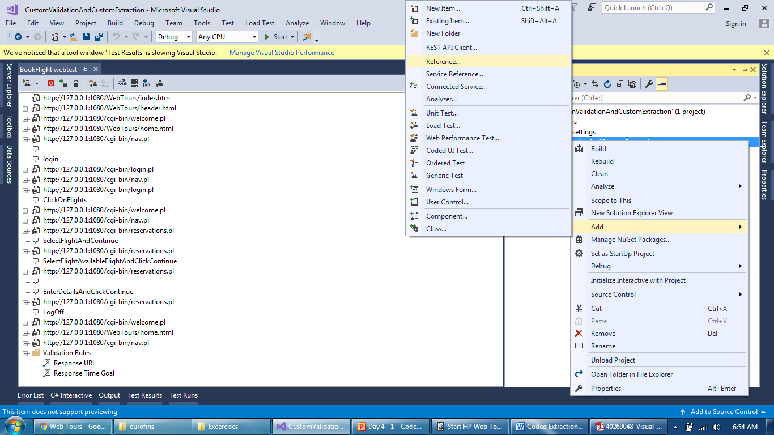
Validation and Request plugin
Go back to Webtest and reference of a DLL

Slide 16
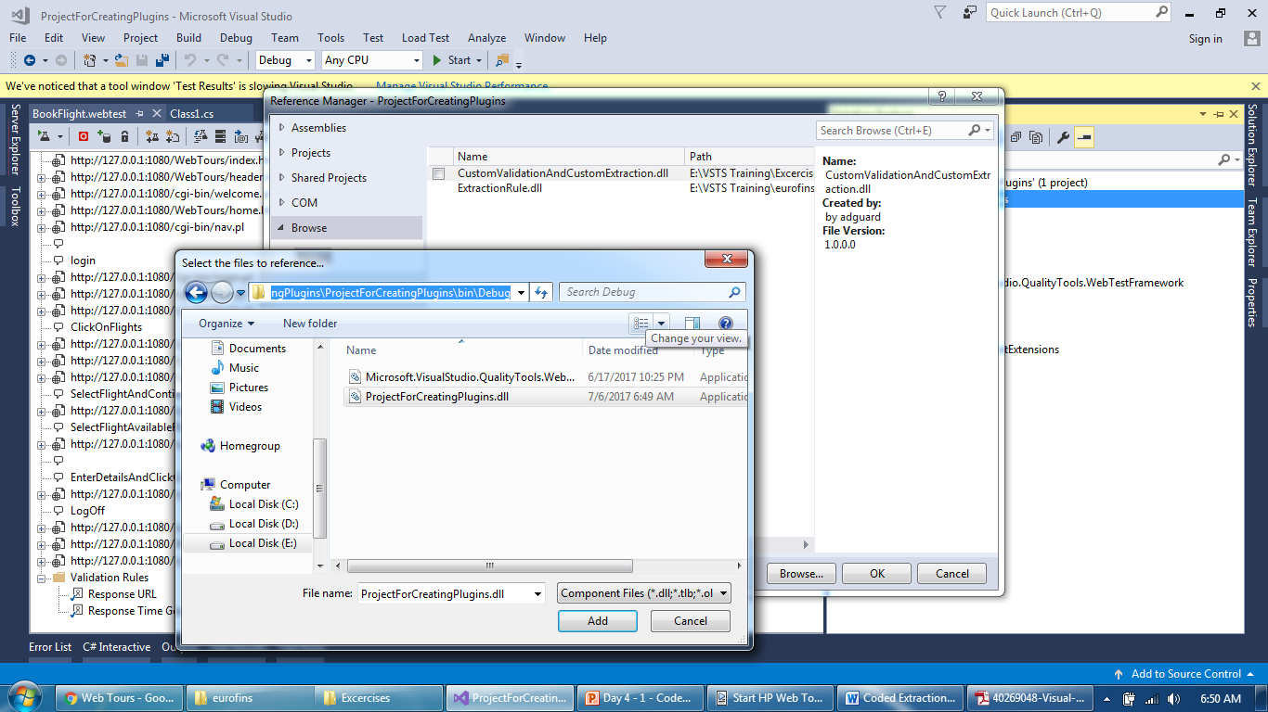
Validation and Request plugin
Go back to Webtest and reference of a DLL

Slide 17
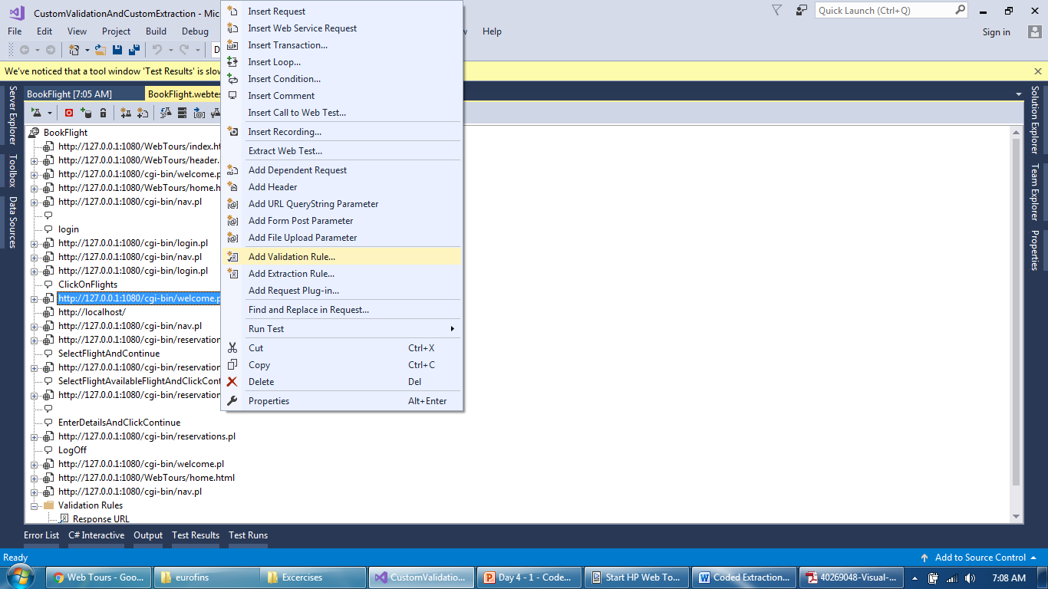
Validation and Request plugin
Add a validation rule on a request which will throw error

Slide 18
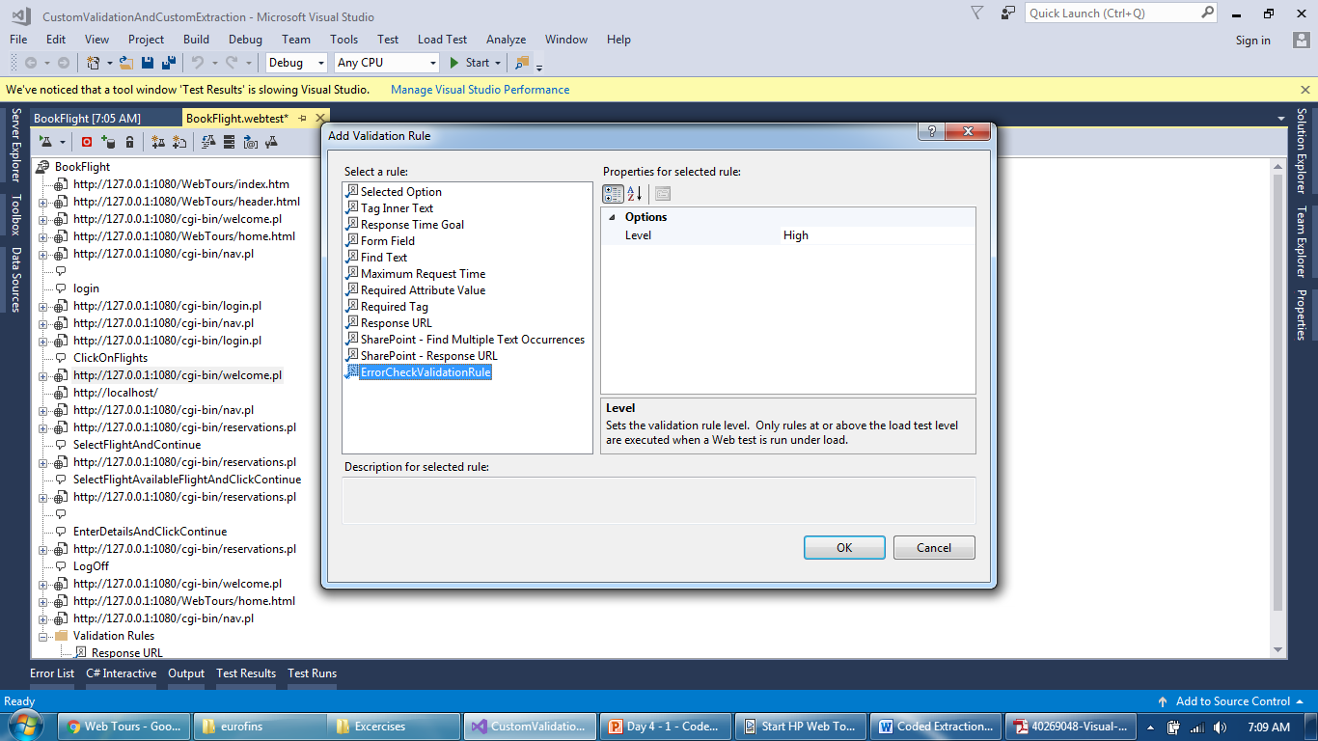
Validation and Request plugin
Add a validation rule created earlier in another project

Slide 19
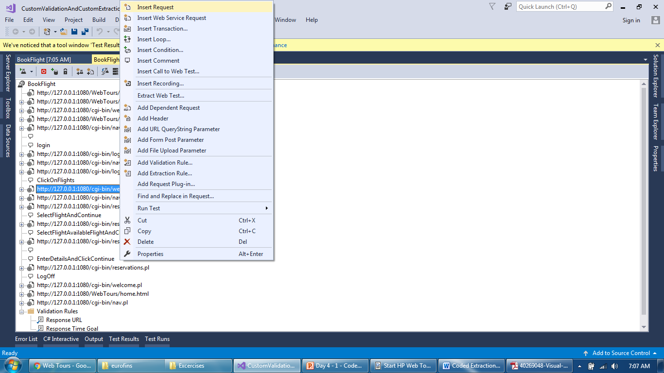
Validation and Request plugin
Add a dummy request after current request

Slide 20
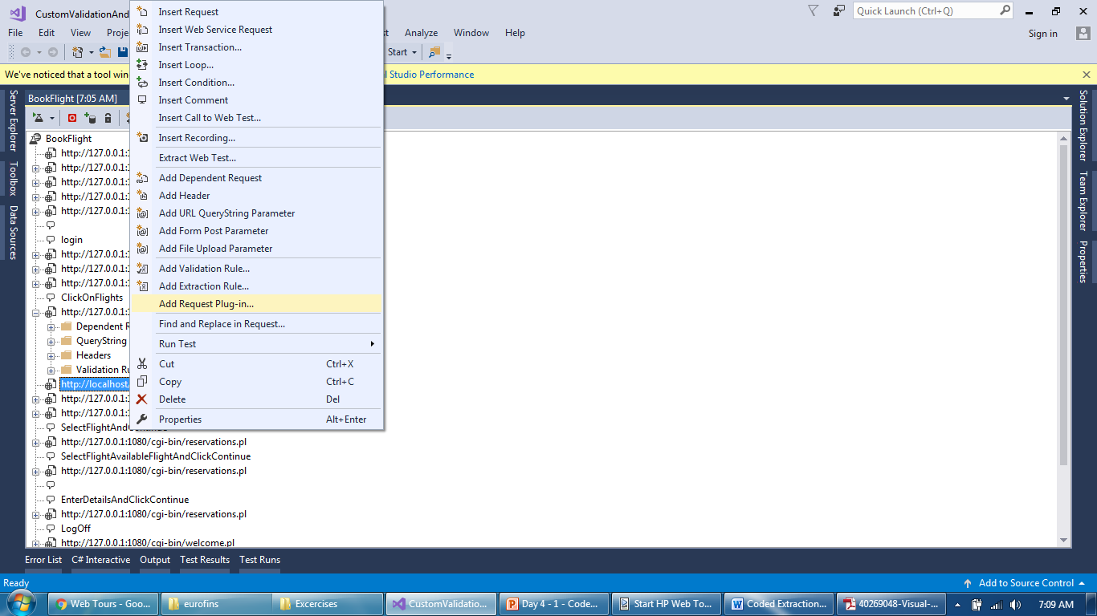
Validation and Request plugin
Add a request plugin to this dummy request

Slide 21
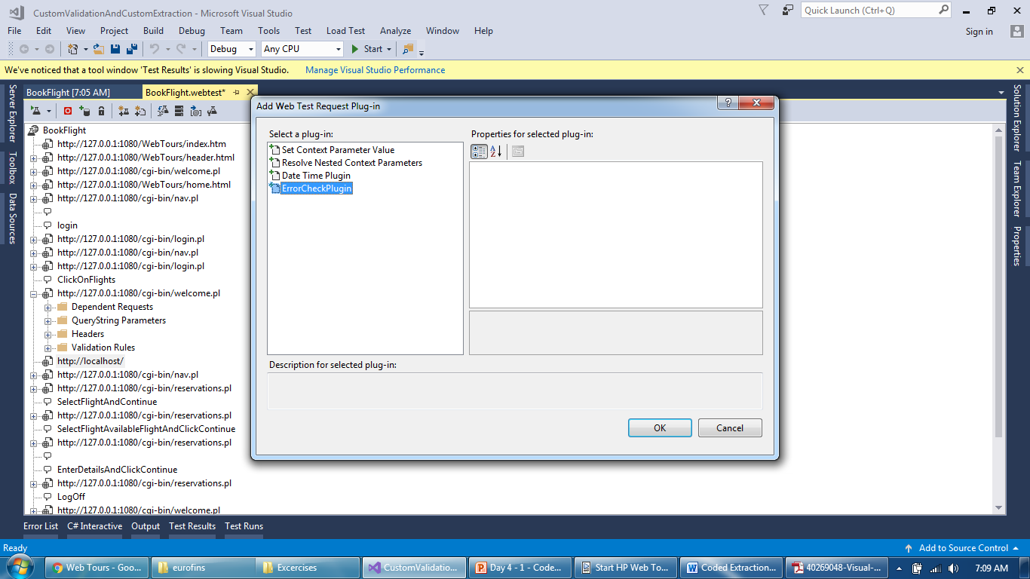
Validation and Request plugin
Select appropriate request plugin

Slide 22
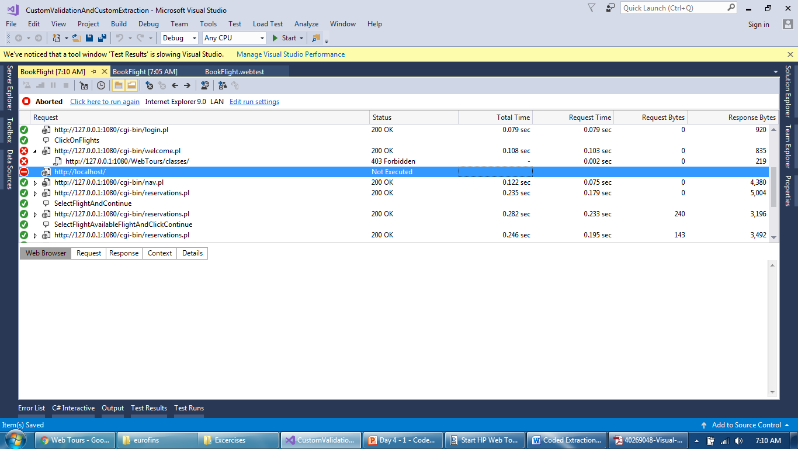
Validation and Request plugin
But dummy request didn’t execute even previous failed

Slide 23
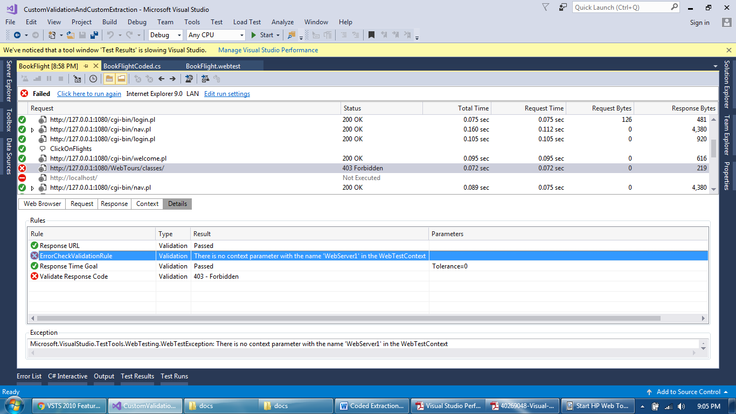
Validation and Request plugin
Check details of failed request, Webserver1 was not created

Slide 24
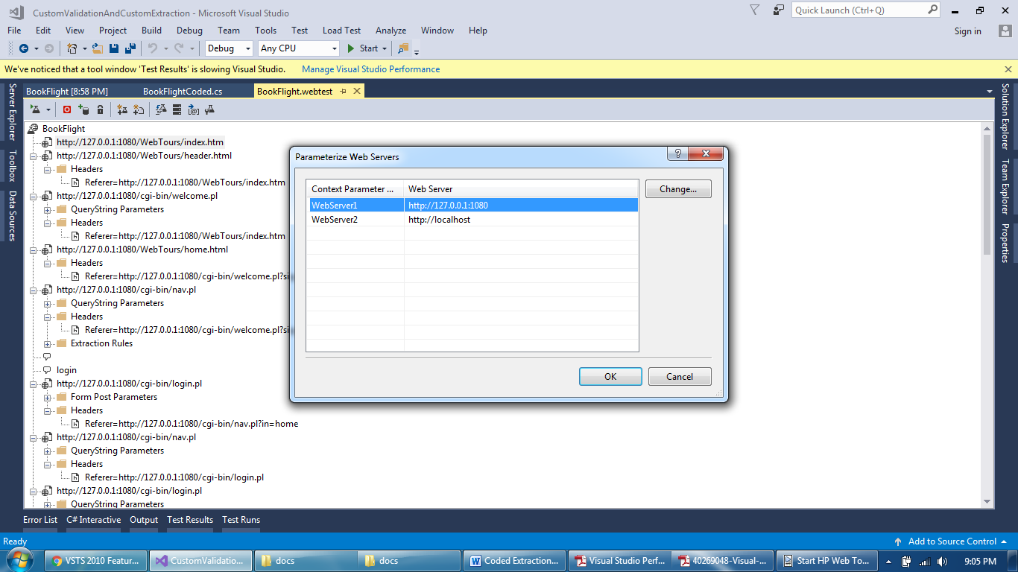
Validation and Request plugin
Create a web server parameter

Slide 25
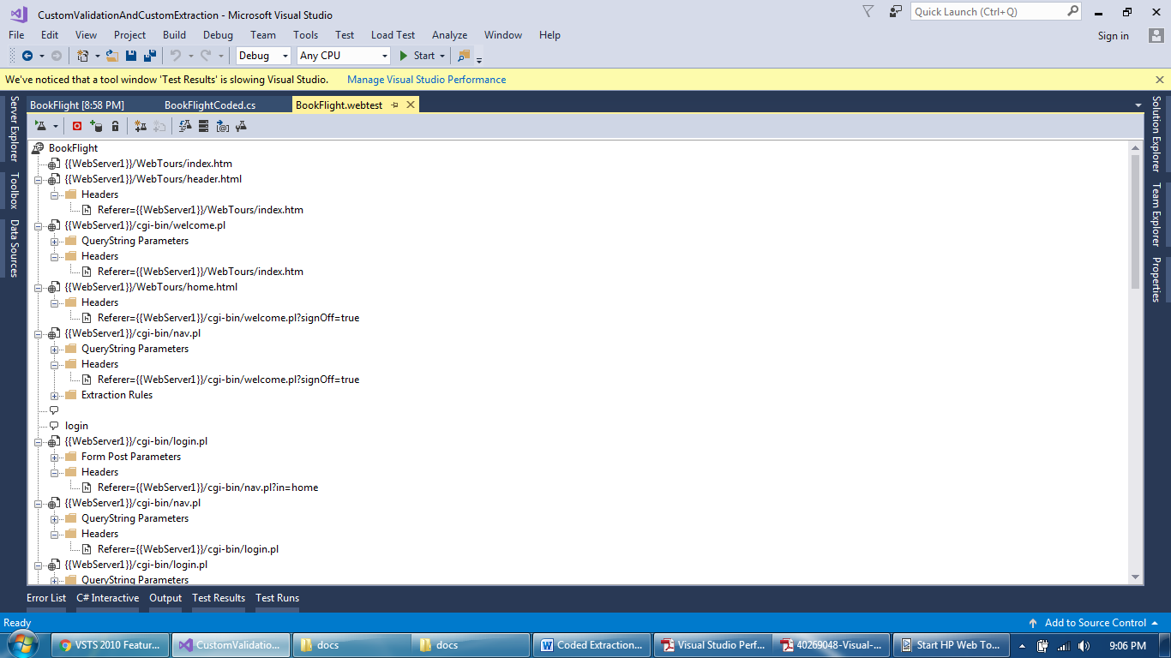
Validation and Request plugin
Webserver parameter Created

Slide 26
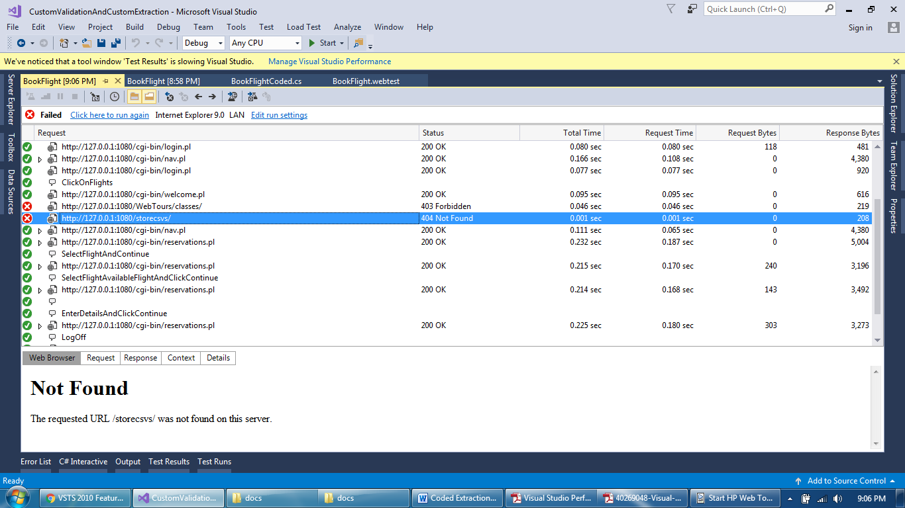
Validation and Request plugin
This time dummy request executed by custom request

Slide 27
Validation and Request plugin
Validation Rule Code
public class ErrorCheckValidationRule : ValidationRule
{
public override void Validate(object sender, ValidationEventArgs e)
{
if (((int) e.Response.StatusCode) >= 400)
{
e.WebTest.Context.Add("ErrorUrl",
e.WebTest.Context["WebServer1"].ToString()+"/storecsvs/");
}
}
}

Slide 28
Validation and Request plugin
Request Code
public class ErrorCheckPlugin : WebTestRequestPlugin
{
public override void PreRequest(object sender, PreRequestEventArgs e)
{
object errorUrl;
if (e.WebTest.Context.TryGetValue("ErrorUrl", out errorUrl))
{
e.Request.Url = errorUrl.ToString();
}
else
{
//if it does not exist then skip the request
e.Instruction = WebTestExecutionInstruction.Skip;
}
}
}

Slide 29
Validation and Request plugin
Debugging in Web Extractor Rule
https://blogs.msdn.microsoft.com/slumley/2009/11/16/debugging-custom-validationextraction-rules-web-test-and-load-test-plug-ins/

Slide 30
Thank You

